Slide 1

A PRESENTATION ON DATA SCIENCE WITH PYTHON
UEFA EURO 2024
Prepared by:
Aakash Rana(04)
Aayush Maharjan(05)
Alka Basnet(08)
Bigyan Moktan(21)
Submitted to: Anmol Adhikari

Slide 2
INTRODUCTION
High-level, interpreted programming language
Known for simplicity and readability
Emphasizes code readability
Expresses concepts in fewer lines of code
Extensive standard library and frameworks
Dynamic typing
Versatility for various applications
Case sensitive

Slide 3
DATA SCIENCE WITH PYTHON
1. Data Manipulation and Analysis
Pandas:
Data structures and functions for manipulating structured data
NumPy:
Supports large, multi-dimensional arrays and matrices
Collection of mathematical functions for array operations
2. Data Visualization
Matplotlib: Comprehensive plotting library
Seaborn: Statistical data visualization
Plotly: Interactive and dynamic visualizations

Slide 4
4. Machine Learning and AI
Scikit-learn: Tools for data mining and data analysis
TensorFlow and PyTorch: Libraries for deep learning
5. Ecosystem and Community
Extensive ecosystem: Integrates well with other data science tools
Large community: Abundant resources, tutorials, and support
6. Real-World Applications
Predictive analytics: Forecasting trends and behaviors
Natural Language Processing (NLP): Analyzing and understanding human language
Computer Vision: Interpreting and understanding visual data

Slide 5
UEFA EURO 2024 DATASET
The UEFA Euro 2024 Championship is a premier football tournament that brings together national teams from across Europe. It showcases top football talent in an intense competition held every four years.
Scope: Contains information about all players in the squads of teams participating in UEFA Euro 2024.
Contents: Includes player details such as clubs, age, height, market value, and other relevant attributes.
Purpose: Designed for exploratory data analysis (EDA) and data visualizations.
Usefulness: Provides insights into player demographics, performance metrics, and team compositions for analytical purposes during the tournament.

Slide 6
PROJECT OVERVIEW
Data Loading
Data loading is the process of importing the dataset into a DataFrame, which is a data structure provided by the pandas library in Python. This is the first step in any data analysis or machine learning project, as it allows you to work with the data in a structured and accessible manner.
Explanation:
pd.read_csv(): This function reads a comma-separated values (CSV) file into a DataFrame.
df: The variable that stores the DataFrame created from the CSV file.
2. Data Preprocessing
Data preprocessing involves transforming raw data into a clean dataset suitable for analysis and modeling.
isnull(): Checks for missing values in the DataFrame.
sum(): Sums the total number of missing values for each column.

Slide 7
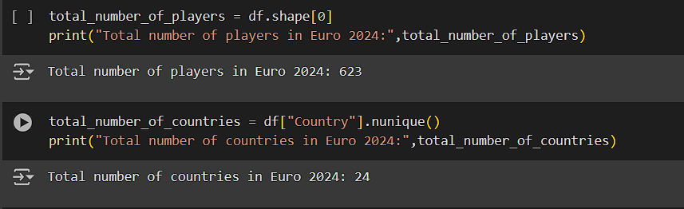
DATA ANALYSIS
623 players in rows
10 features (column)
Name, Position, Club, Foot, Country - String type
Age, Height, Caps, Goals, Market Value - Int type
24 total Nations

Slide 8
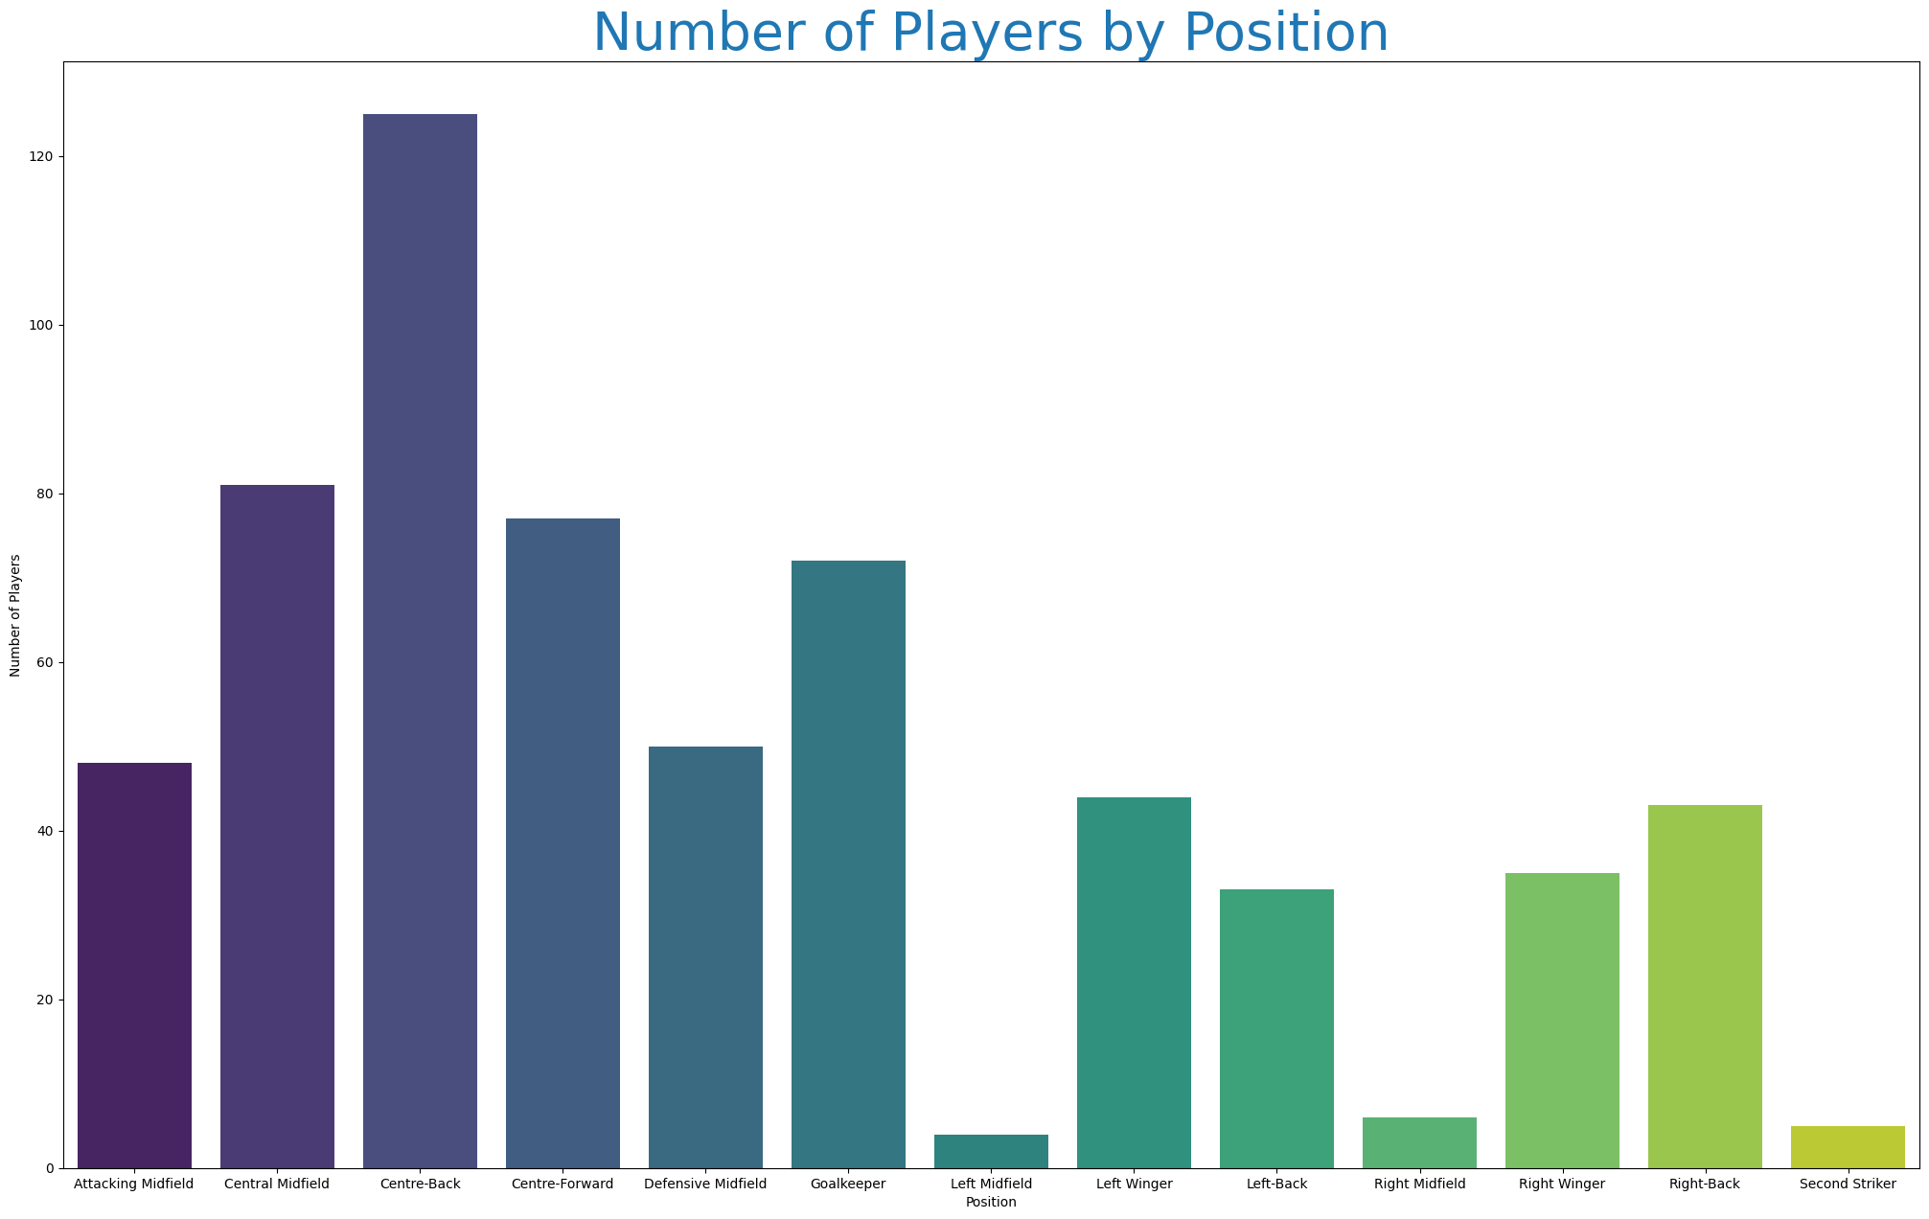
VISUALIZATION OF PLAYERS PLAYING IN SPECIFIC POSITION

Slide 9
GROUPING POSITIONS
As from previous slide, there are 13 Positions a player can play.
can be grouped into 4 main Positions:
GOALKEEPER
DEFENDER
MIDFIELDER
ATTACKER
THUS, attacker df was created consisting these positions

Slide 10
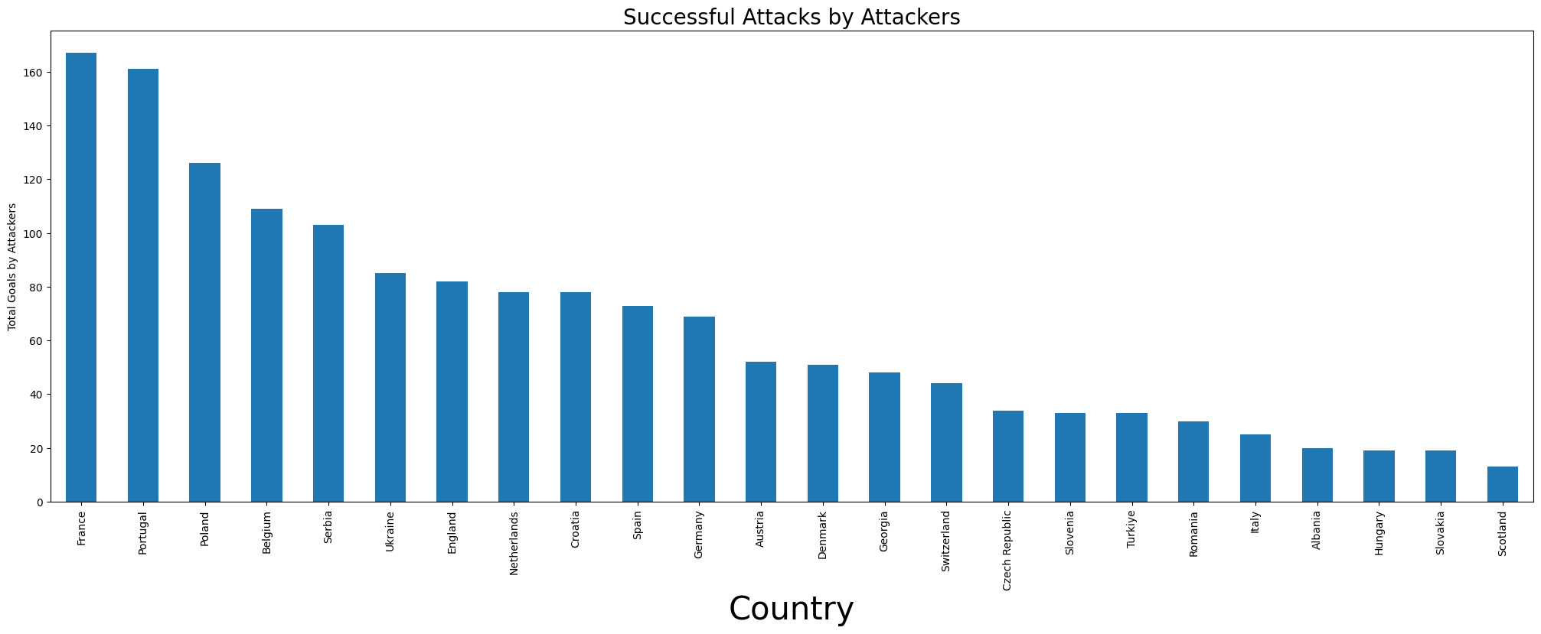
It was used to visualize successful attacks by the attackers of each countries

Slide 11
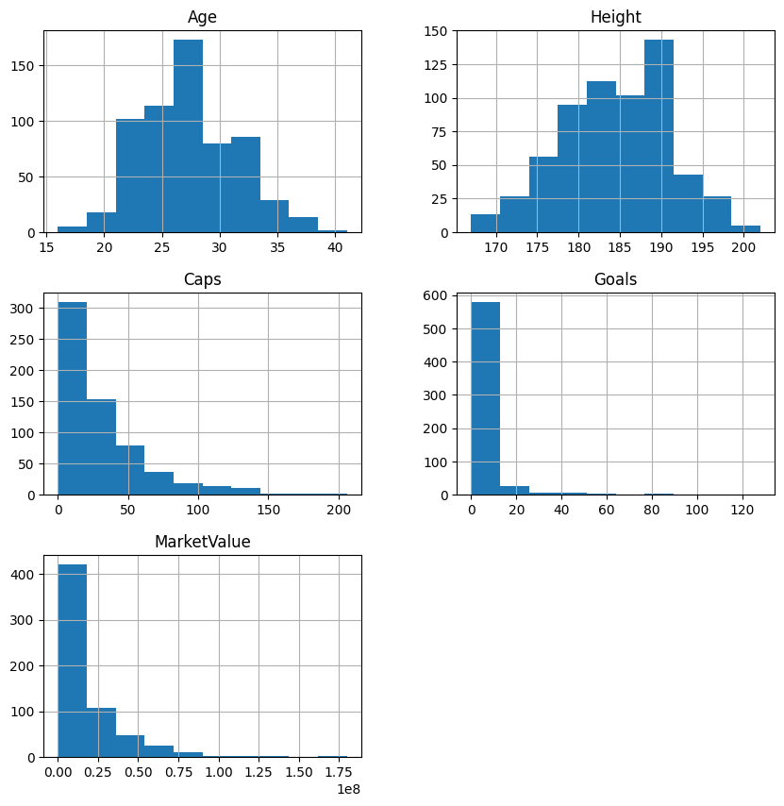
DATA DISTRIBUTION OF PLAYERS
AGE
HEIGHT
MARKET VALUE
GOALS

Slide 12
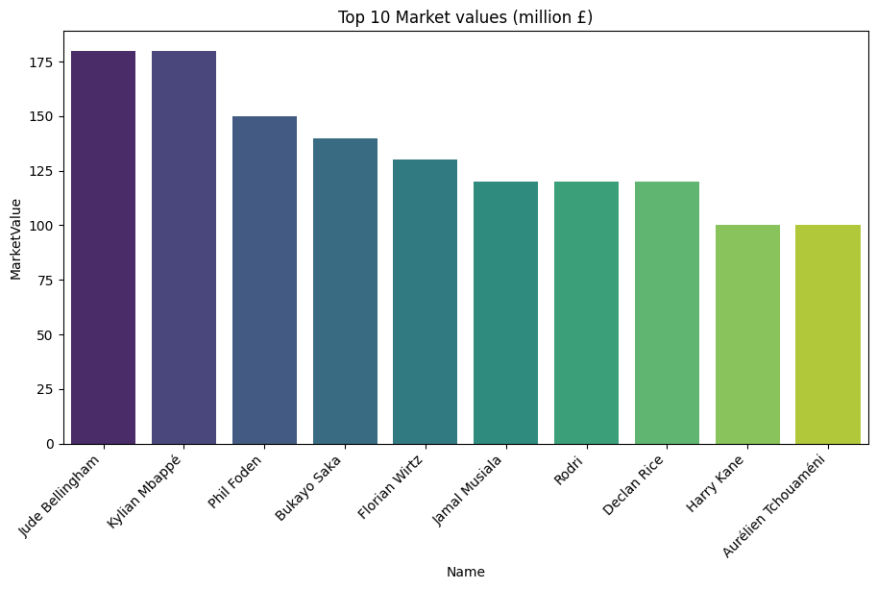
TOP 10 MOST EXPENSIVE PLAYERS

Slide 13
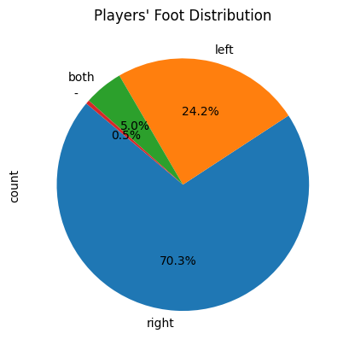
FOOT DISTRIBUTION
Right foot players > left foot
only 5 % players use both feet
0.5 % players doesn't have specified foot

Slide 14
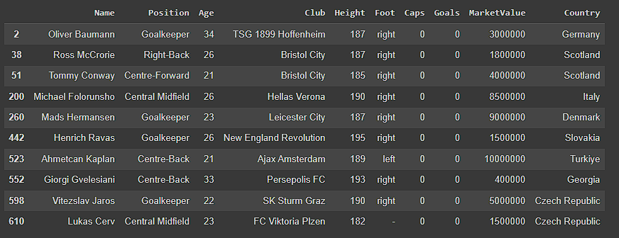
DEBUT PLAYERS
Caps value gives the total number of appearance for the nation.
Using that feature, we found there were 10 DEBUT players for their countries.

Slide 15
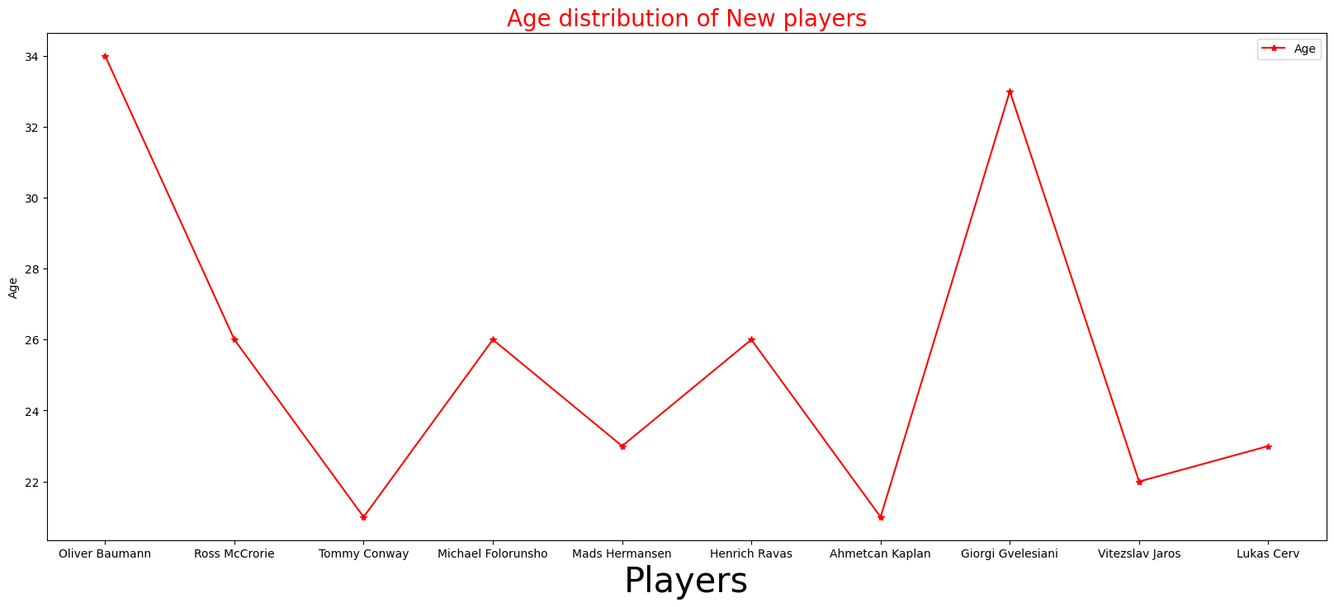
USING THE 10 DEBUT PLAYERS, AGE DISTRIBUTION VISUALIZED

Slide 16
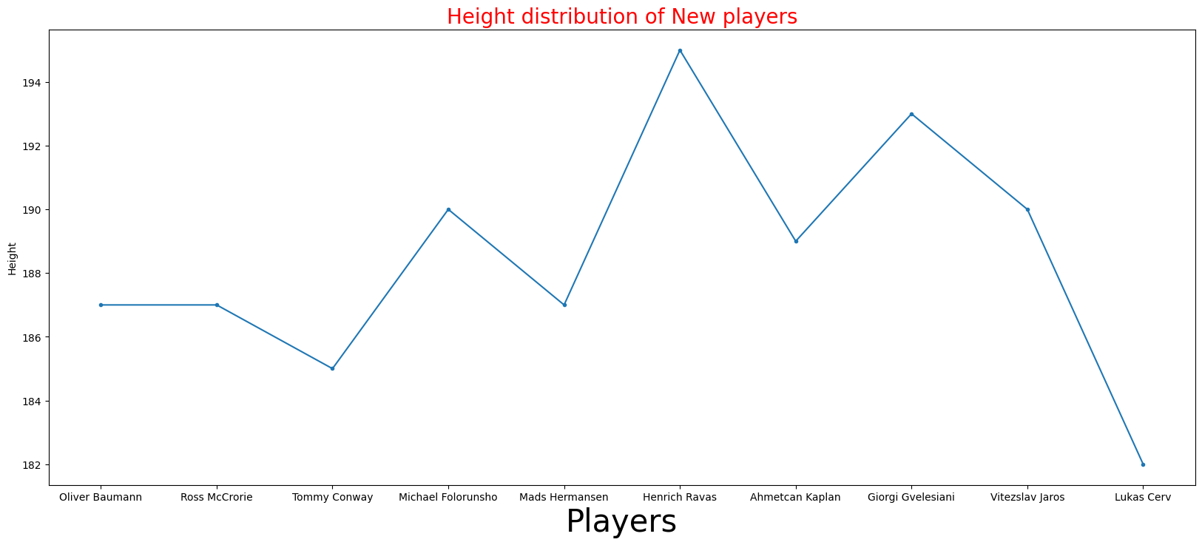
USING THE 10 DEBUT PLAYERS, HEIGHT DISTRIBUTION VISUALIZED

Slide 17
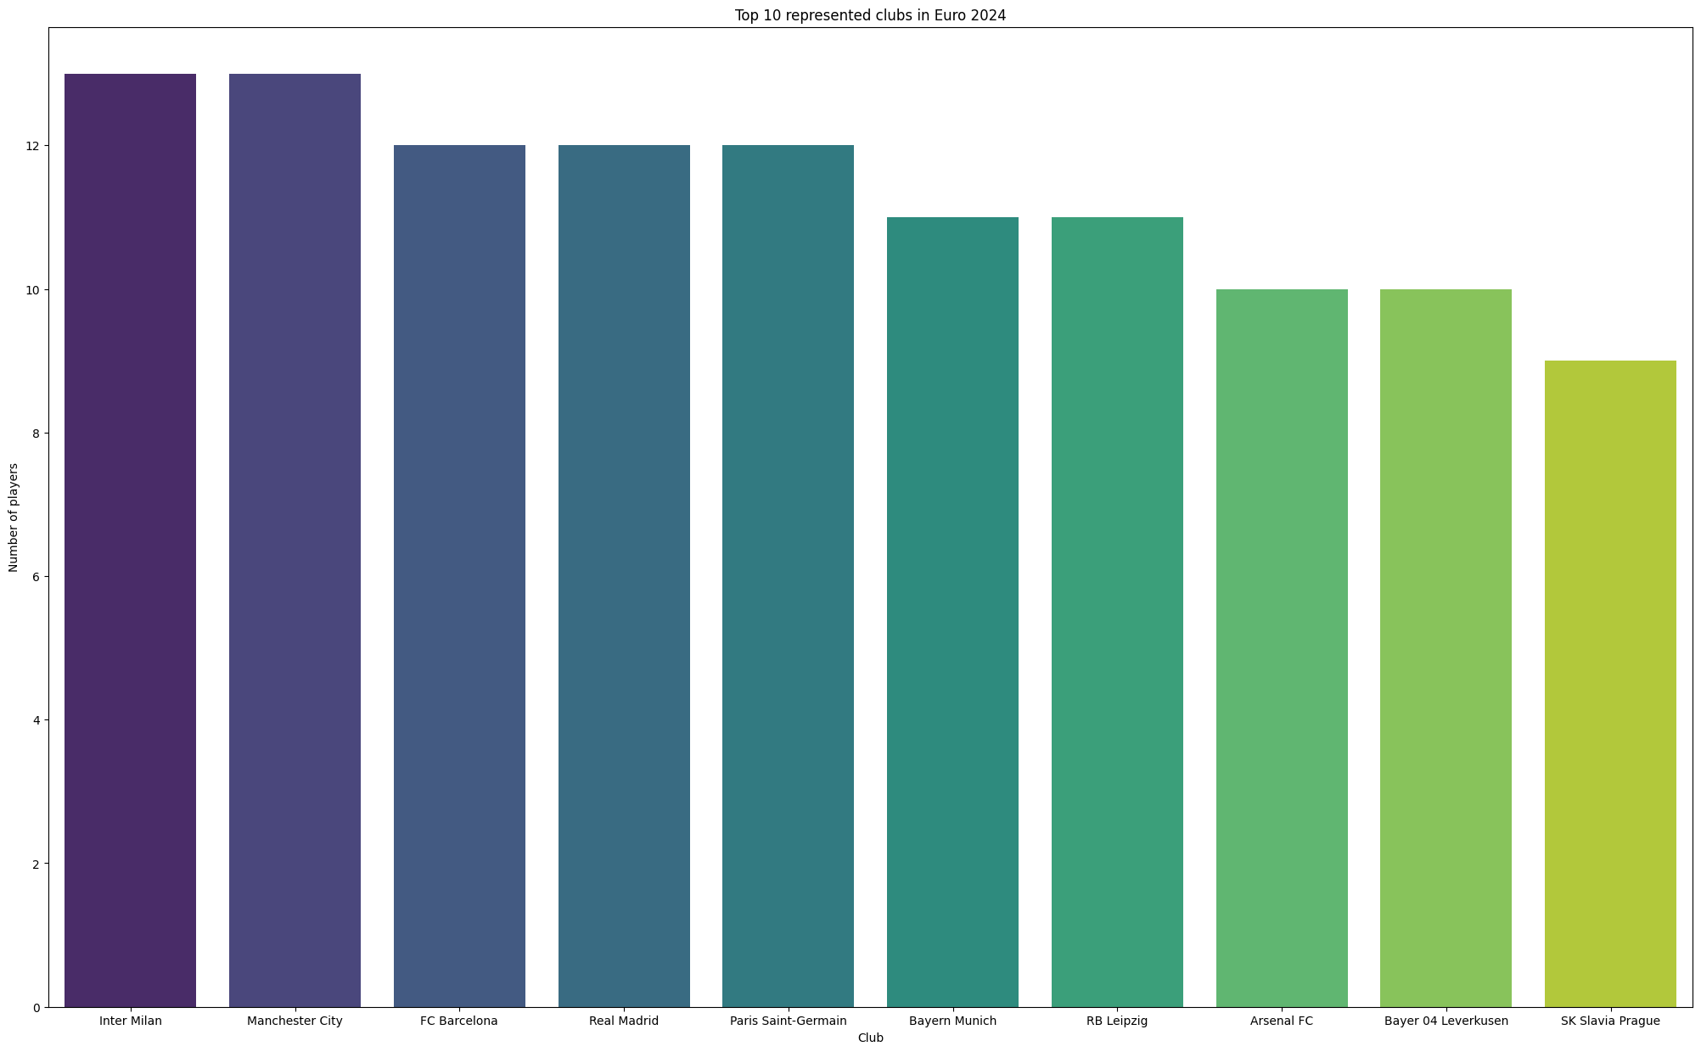
TOP 10 REPRESENTED CLUBS

Slide 18
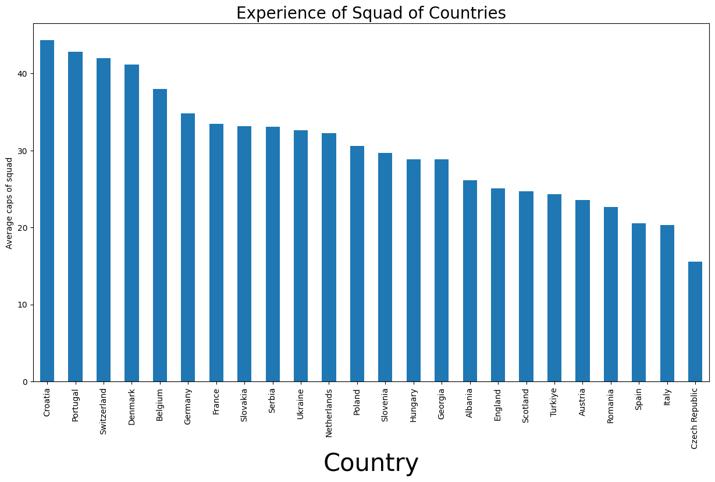
EXPERIENCE OF NATIONS
Higher the mean value,greater is the experience and vice versa
mean caps value calculated

Slide 19
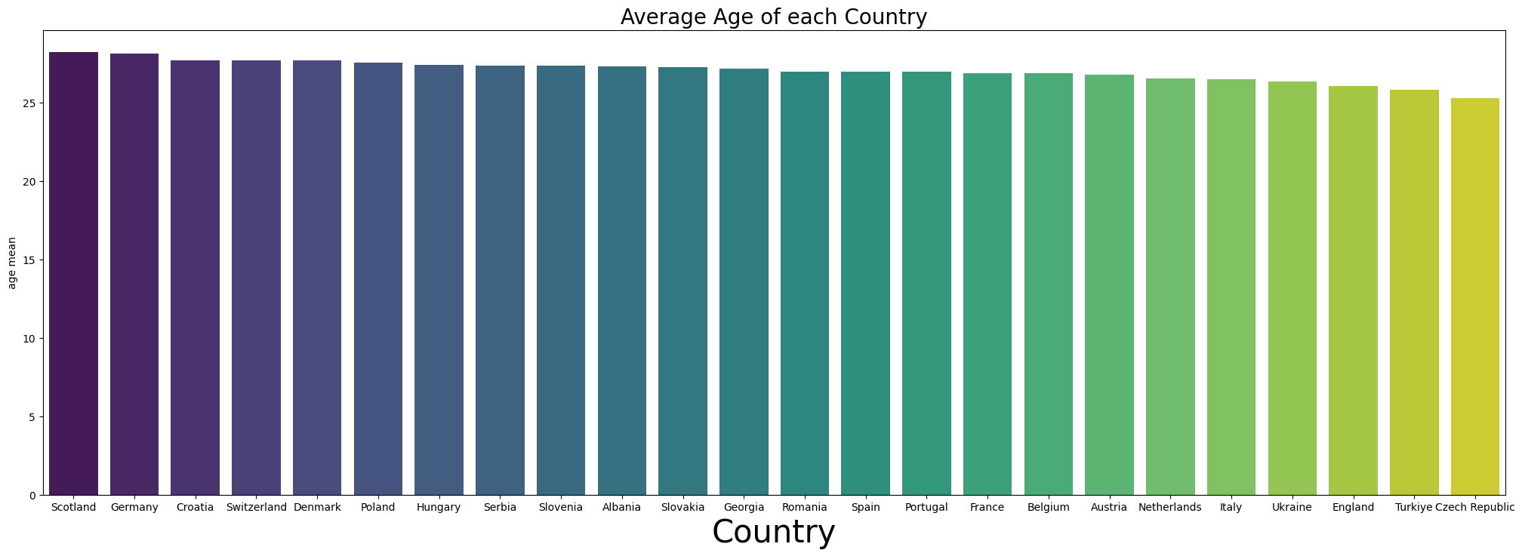
AVERAGE AGE OF COUNTRIES
Mean Age calculated of each players representing their countries.
Scotland has the Oldest teams
may focus on experience
Czech Republic has the youngest on average
focus on agility

Slide 20
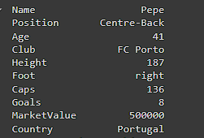
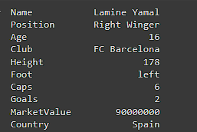
COMPARISON OF OLDEST AND YOUNGEST PLAYER
OLDEST PLAYER VS YOUNGEST PLAYER

Slide 21
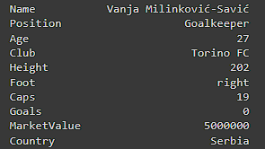
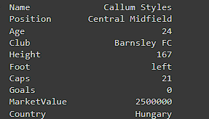
COMPARISON OF PLAYER’S HEIGHT
TALLEST PLAYER VS SHORTEST PLAYER

Slide 22
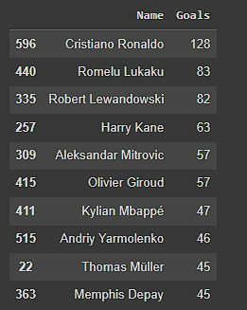
TOP 10 GOALSCORERS IN INTERNATIONAL
CR7 has the most goals
Mbappe has 47 goals at this young age
Lukaku and Lewandowski fighting for
2nd most goals

Slide 23
THANK YOU

